Slide 1
Designing Biomimetic Twisted Polymer Torsional Actuators
Heidi P. Feigenbaum, Associate Professor, Northern Arizona University
Michael W. Shafer, Assistant Professor, Northern Arizona University
Diego R. Higueras Ruiz, M.S. Candidate, Northern Arizona University
Amy Swartz, M.S. Candidate, Northern Arizona University
SMASIS 2017, Snowbird, UT, USA, September 19, 2017

Slide 2
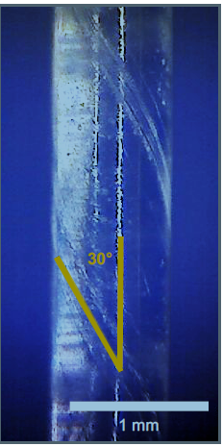
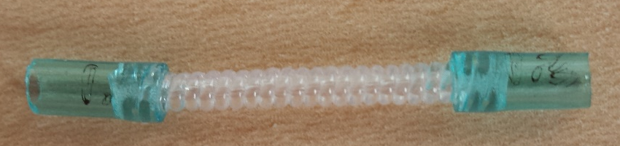
Twisted Polymer Actuators
Drawn Polymer Monofilaments: Fishing line
Extremely inexpensive
Twisted Polymer Actuators (TPAs)
Anneal twisted drawn polymer monofilaments
Straight-Twisted Polymer Actuators (STPAs)
Torsional actuation
Twisted Coiled Polymer Actuators (TCPAs)
Linear actuation

Slide 3
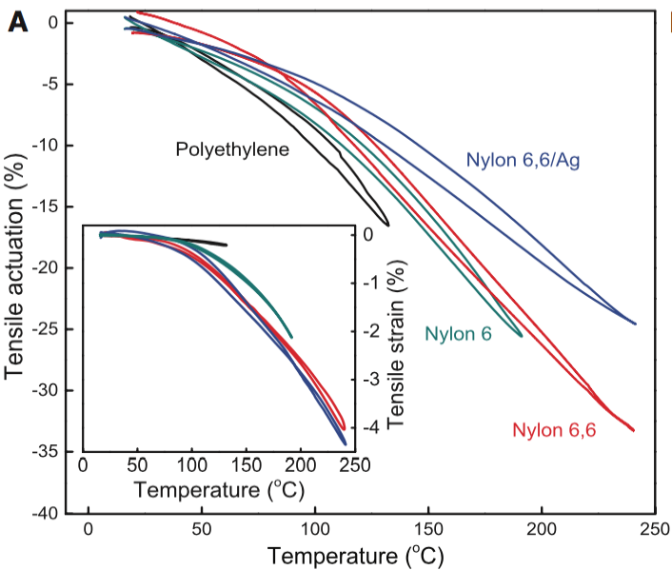
Previous Work
[Haines et al. 2014]
TCPAs have striking performance characteristics
Specific load capacity higher than human muscle [Haines et al. 2014]
Low actuation hysteresis [Haines et al. 2014]
Low creep (~1.5% ) over 1.2 million cycles [Haines et al. 2014]
Similarly impressive performance of STPAs in torsion
STPAs building blocks of TCPAs

Slide 4
This Work
Designing STPAs
Actuation process of STPAs
Testing torsional STPAs
Two configuration
Review models for the themal behavior of STPAs
Measuring thermal expansion
Key part of models and actuation process
Predicting torsional actution of STPAs

Slide 5
Mechanics of STPAs
Prevorsek microstructural model
Heated precursor fiber radially expands
Precursor Fiber
(monofilament)
ΔT
Twist under tensile load. Thermally anneal.
Straight-twisted polymer actuator (STPA)
ΔT
High stiffness polymer chain now wraps around larger circumference causing shear deformation.
Crystallite
Amorphous
Interfibrillar
tie chains

Slide 6
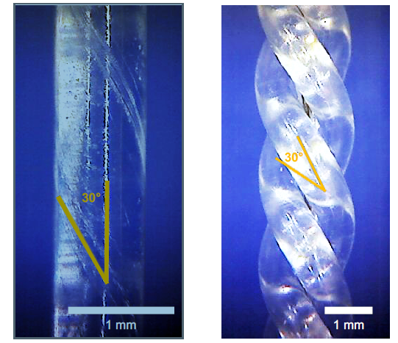
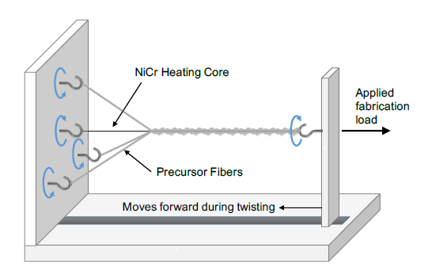
Testing STPAs
Configuration 1 – single monofilament of STPA
Simpler
Configuration 2 – 3 parallel STPAs gently twisted together (like rope)
Larger loads
Potential for heating wire core
The twisting together must be gentle or else create a linear actuator
Nylon 6 - Berkley Trilene Big GameTM 80lb monofilament
All materials used were desiccated

Slide 7
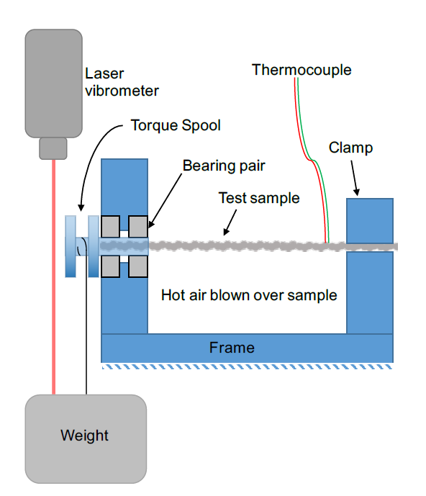
Experimental Methods

Slide 8
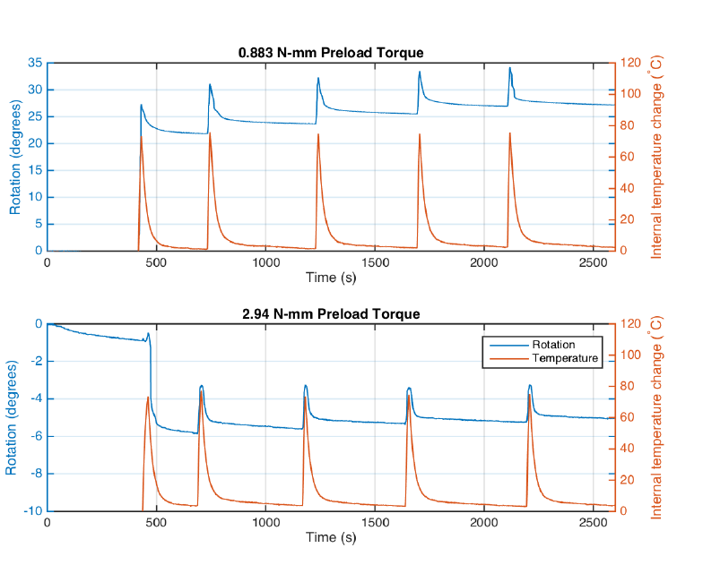
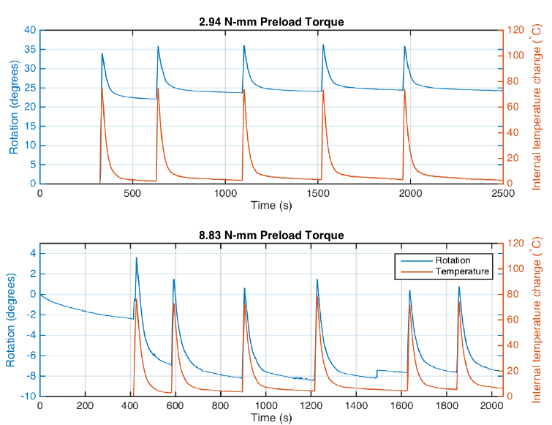
Experimental Results
Config. 1 – single STPA
Config. 2 – parallel
Pre-load per cross-sectional area equivalent for the two designs
More torsional stroke with parallel configuration
Notice the first cycle effect
Nearly full recovery after first few cycles
Notes:
Shows actuation behavior. But ideally for design you want to be able to model and optimize the configuration. To do that you need a model!

Slide 9
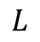
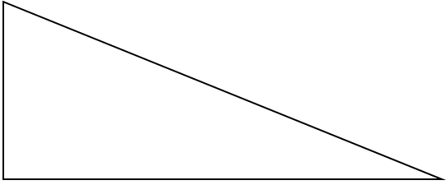
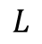
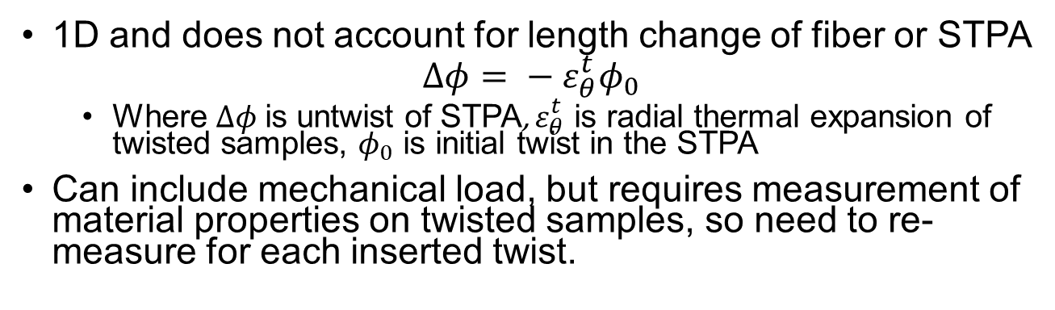
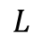
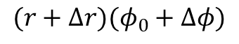
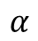
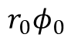
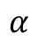
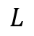
Aziz et al. [2016] Model for STPAs
1D and does not account for length change of fiber or STPA
$$Δφ= − ε_{θ}^{t}φ_{0}$$
Where $Δφ$ is untwist of STPA, $ε_{θ}^{t}$ is radial thermal expansion of twisted samples, $φ_{0}$ is initial twist in the STPA
Can include mechanical load, but requires measurement of material properties on twisted samples, so need to re-measure for each inserted twist.
Before heating
Fiber length
$$L$$
$$L$$
$$α$$
$$α$$
$$r_{0}φ_{0}$$
After heating
$$L$$
$$L$$
Fiber length
$$(r+Δr)(φ_{0}+Δφ)$$

Slide 10
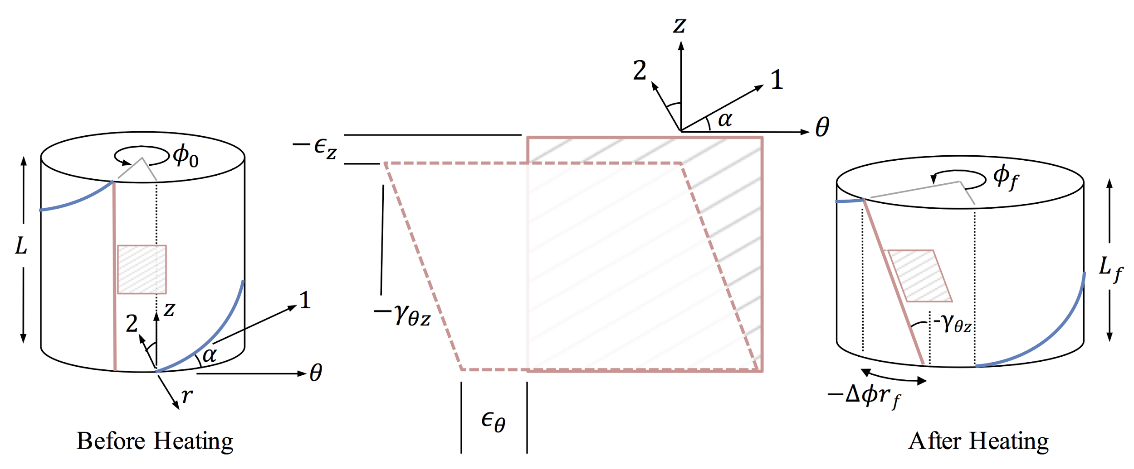
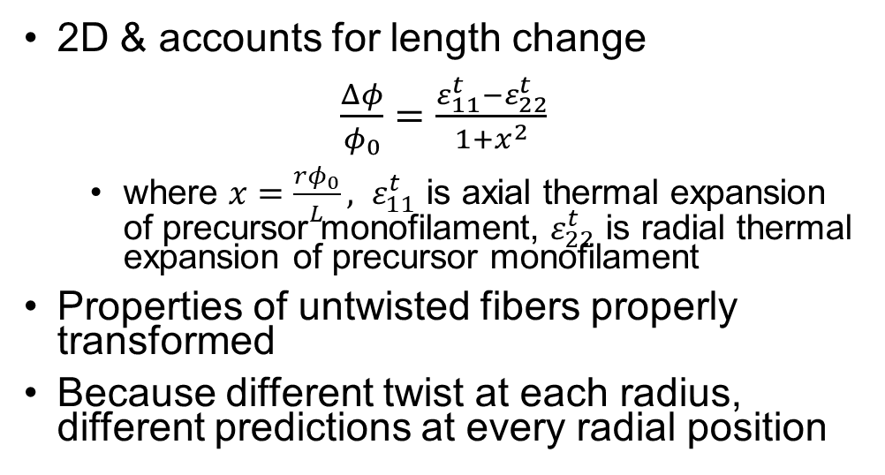
Shafer et al. [2016] Model for STPAs
2D & accounts for length change
$\frac{Δφ}{φ_{0}}=\frac{ε_{11}^{t}−ε_{22}^{t}}{1+x^{2}}$
where $x=\frac{rφ_{0}}{L}, ε_{11}^{t}$ is axial thermal expansion of precursor monofilament, $ε_{22}^{t}$ is radial thermal expansion of precursor monofilament
Properties of untwisted fibers properly transformed
Because different twist at each radius, different predictions at every radial position

Slide 11
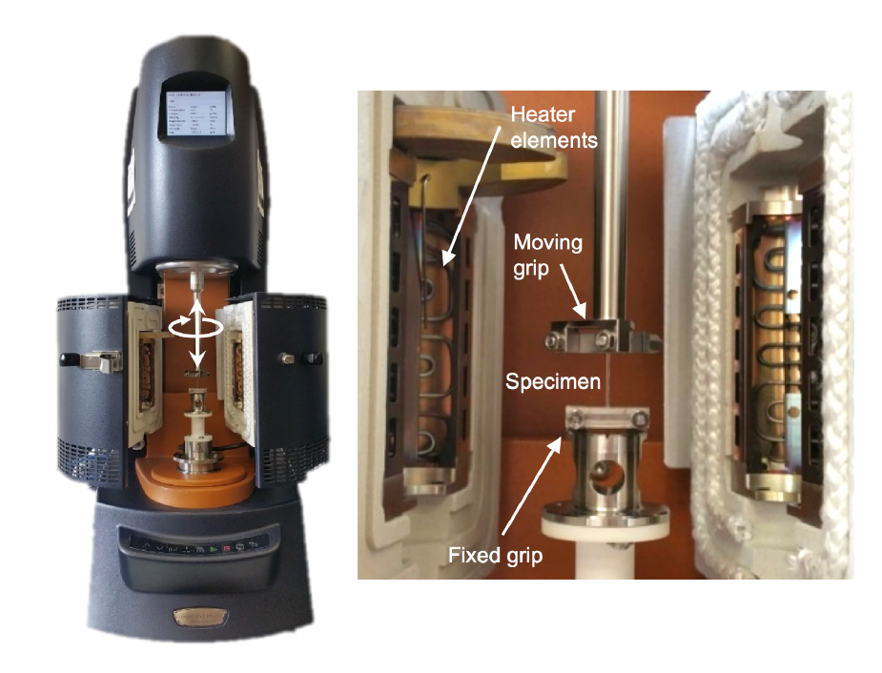
Calibration of Models
Aziz et al.
Initial twist of STPA
Radial expansion of twisted
Shafer et al.
Initial twist, radius, and length of STPA
Radial and axial thermal expansion of untwisted monofilament
Axial Thermal Expansion

Slide 12
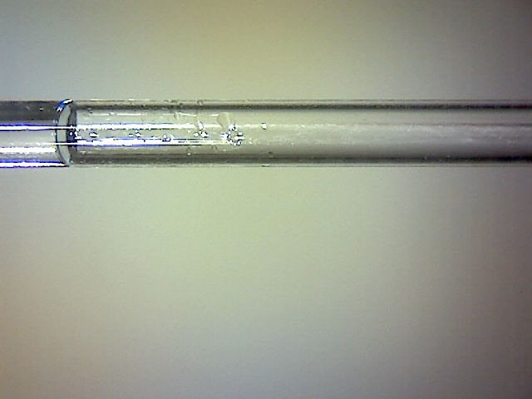
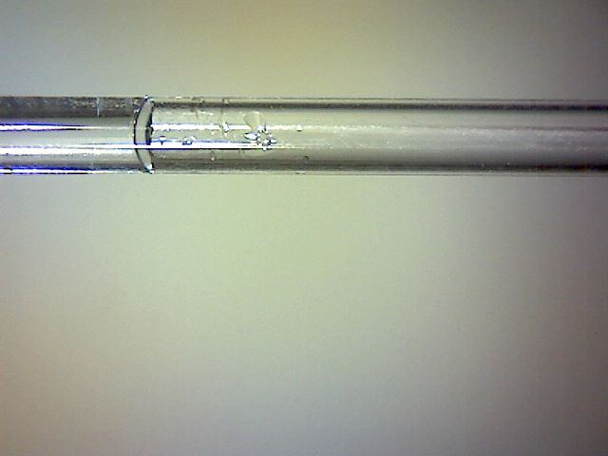
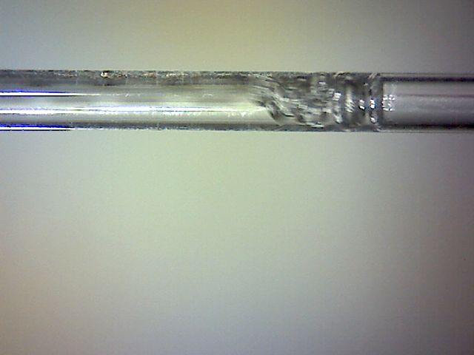
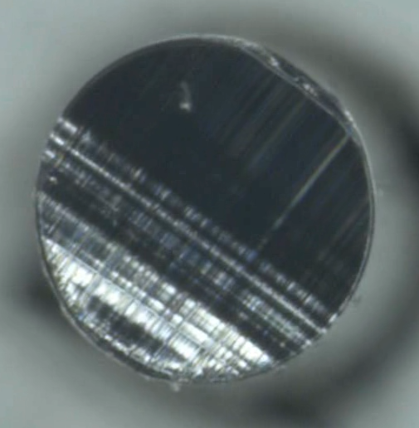
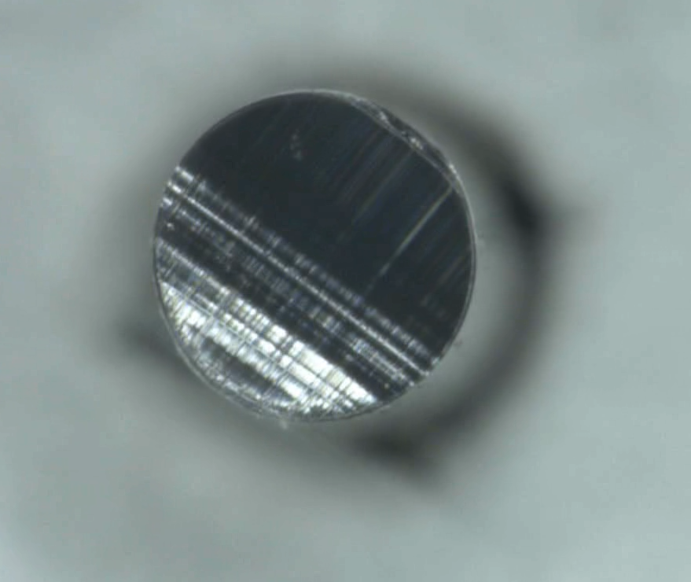
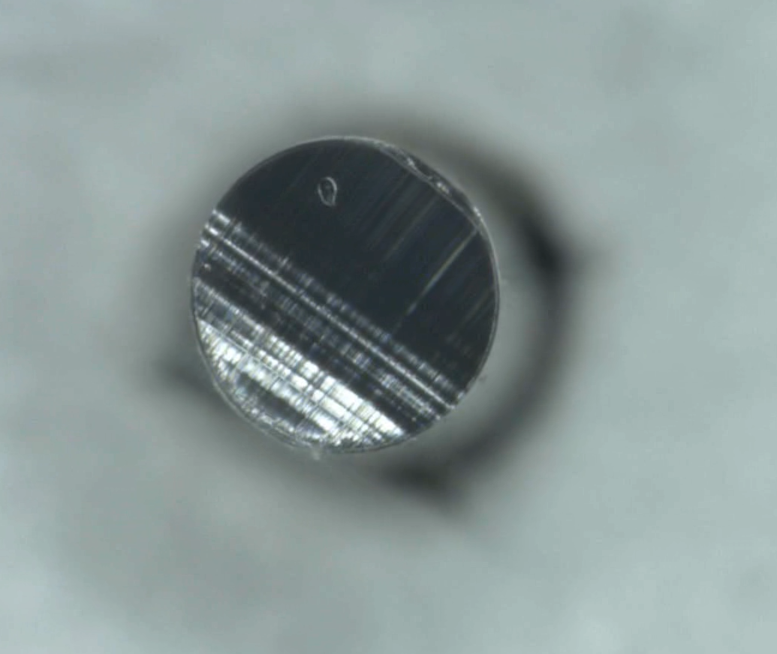
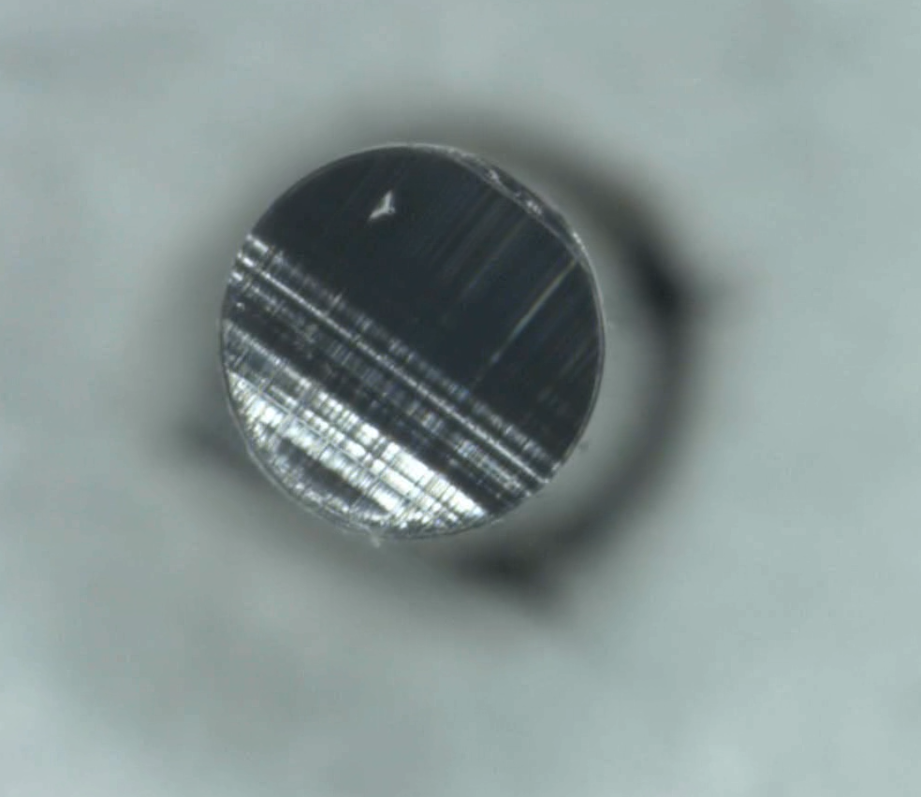
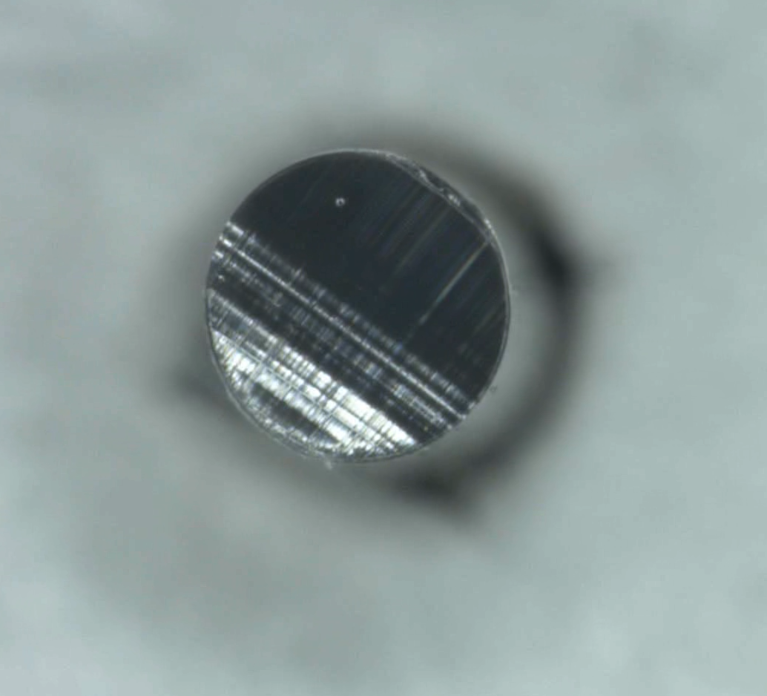
Radial Thermal Expansion
Displacement in oil baths
Multiple fibers in graduate cylinder
Measure volume change & subtract axial expansion
Resolution poor
Single fiber in capillary tube
Issue with bubbles
Suggest water release
Capillary Test Results
T = 20 C
T ~ 100 C
Vapor bubble migration in sample
T = 20 C
T = 100 C
→ Need to control for humidity! We desiccate samples.

Slide 13
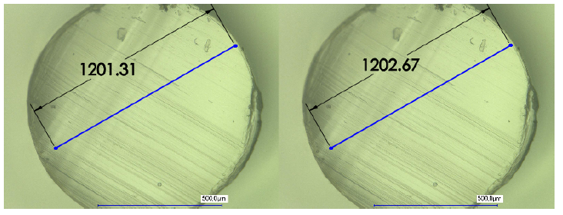
New Method for Radial Expansion
Keyence Digital Microscope under 300x magnification
Samples
All desiccated
All cut into slices ~0.5 mm thick using a microtome
Untwisted & Twisted
Some stretch during annealing (pre-strained)
Some thermally pre-cycled
The distance between two arbitrary points was tracked over the temperature range and used to calculate radial thermal strain.
30ºC
41ºC

Slide 14
Radial Thermal Expansion Results
Highly repeatable radial thermal strains
Results nearly the same with and without twist
Results nearly the same with and without pre-strain
Nearly full recovery & minimal hysteresis after thermally pre-cycled
No thermal pre-cycle
Thermally pre-cycle

Slide 15
Predicting Free Torsion

Slide 16
Conclusions & Future Work
Much promise for use of TPAs
Need to control humidity
We use desiccated samples
Need to pre-cycle before use
First few cycles actuate differently than all subsequent cycles
Radial thermal expansion fully recovers with minimal hysteresis if thermally pre-cycle
Radially thermal expansion independent of twist and pre-strain
Shafer et al. [2016] model predicts free torsion reasonably well
Future Work:
Modeling STPAs with thermal and mechanical loading using precursor properties
Predict actuation results
Design initial twist
Modeling of TCPAs

Slide 17
Thank you for your attention!
Questions?

Slide 18
TPA Fabrication & Actuation Processes
Fabrication
Actuation
Precursor Fiber
(monofilament)
ΔT
Precursor fibers expand radially (and contract axially – not shown) when heated
Twist & anneal
High stiffness polymer chain now wraps around larger circumference causing shear stress and deformation due to low shear stiffness.
Straight-twisted polymer actuator (STPA)
ΔT
Twist/coil & anneal.
Torsional response of STPA translates to contraction of TCPA.
Twisted-coiled Polymer Actuator (TCPA)
ΔT
Contraction

Slide 19
Asymmetric thermal expansion
Actuation thought to be driven by asymmetric thermal expansion
Asymmetric thermal expansion thought to be driven by the microstructure [Prevorsek et al. 1973, Bruno et al. 1998]
Inter-fibril tie chains vibrate mainly radially → radial expansion & axial contraction
Amorphous
Crystalline
Inter-fibril tie chain

Slide 20
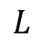
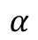
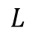
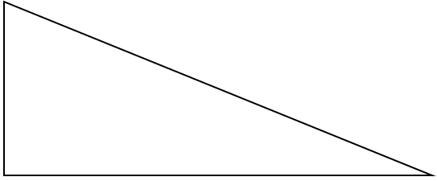
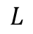
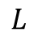
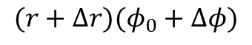
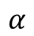
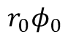
Modeling the thermal behavior of STPAs
Before Heating
Fiber length
$$L$$
$$L$$
$$α$$
$$α$$
$$r_{0}φ_{0}$$
$$L$$
$$L$$
Fiber length
After Heating
$$(r+Δr)(φ_{0}+Δφ)$$

Slide 21
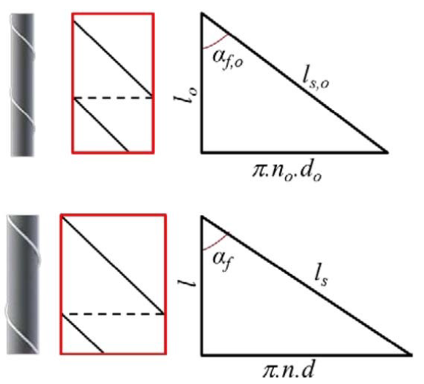
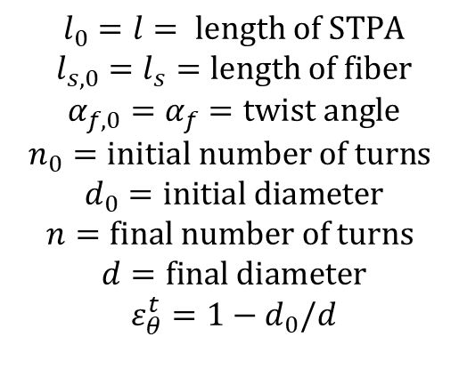
[Aziz et al. 2016]
$$l_{0}=l= length of STPA$$
$$l_{s,0}=l_{s}=length of fiber$$
$$α_{f,0}=α_{f}=twist angle$$
$$n_{0}=initial number of turns$$
$$d_{0}=initial diameter$$
$$n=final number of turns$$
$$d=final diameter$$
$$ε_{θ}^{t}=1−d_{0}/d$$

Slide 22
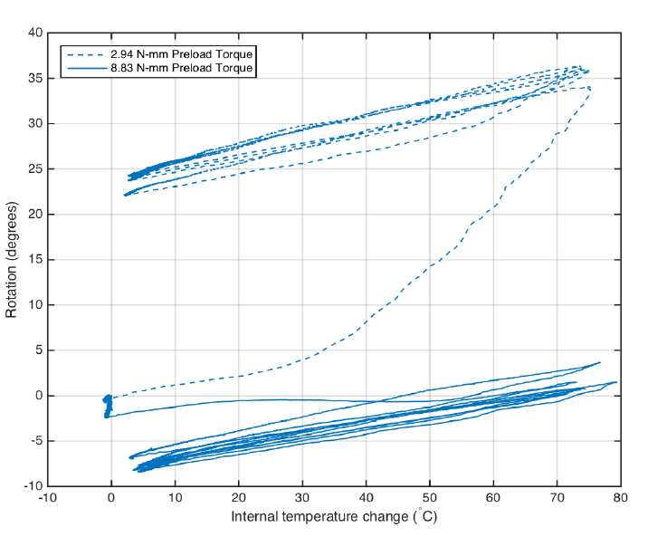
Experimental Results

